Slide 1
Unit 5
ANALOG AND DIGITAL LINKS

Slide 2
Overview of Analog Links
Basic Elements of Analog Link
Optical Transmitter
Optical Fiber Channel
Optical Amplifier
Optical Detector

Slide 3
Carrier – to – Noise Ratio (CNR)
It is the ratio of r.m.s. carrier power to r.m.s. noise power at the receiver.
CNR requirement can be relaxed by changing the modulation format from AM to FM
The BW of FM carrier is considerably larger (30 MHz in place of 4 MHz).
The required CNR for FM receiver is much lower (16 dB compared to 50 dB in AM) because of FM advantage. As a result, the optical power needed at the receiver can be small as 10 μW.

Slide 4
The important signal impairments
It includes,
Laser intensity noise fluctuations.
Laser clipping noise.
Photodetector noise.
Optical Amplifier Noise (ASE noise).
Harmonic noise.
Intermodulation noise.
Shot noise.

Slide 5
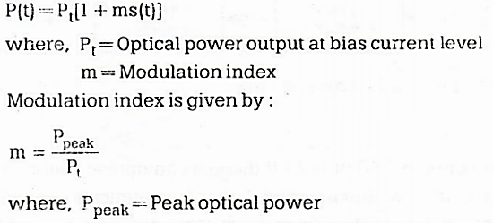
Carrier Power

Slide 6
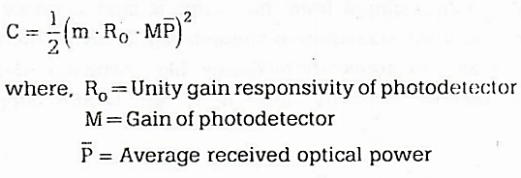
If the received signal is sinusoidal, carrier power C at the output of receiver is given by

Slide 7
Photodetector And Preamplifier Noises

Slide 8
Relative Intensity Noise (RIN)
The two fundamental noise mechanisms
i) Spontaneous emission and
ii) Electron-hole recombination (shot noise).
The noise resulting from the random intensity fluctuations is called Relative Intensity Noise (RIN).

Slide 9
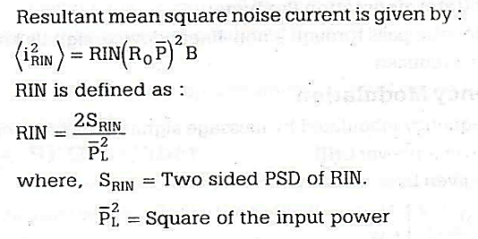
Relative Intensity Noise (RIN)

Slide 10
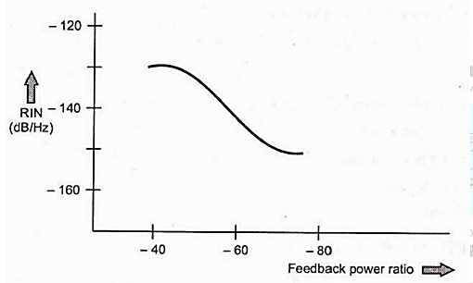
Reflection Effects on RIN
The optical reflections generated within the systems are to be minimized. The reflected signals increases the RIN by 10 – 20 dB.

Slide 11
Limiting Conditions
When optical power level at receiver is low, the preamplifier noise dominates the system noise. The quantum noise of photo detector also dominates the system noise. The reflection noise also dominates the system noise.
The carrier-to-noise ratio for all three limiting conditions is shown in table.
For low light levels, thermal noise is limiting factor causes 2 dB roll of in C/N for each 1 dB drop in received power. At intermediate levels, quantum noise is limiting, factor causing 1 dB drop in C/N for every 1 dB decrease in received optical power. At high received power source noise is dominator factor gives a constant C/N.

Slide 12
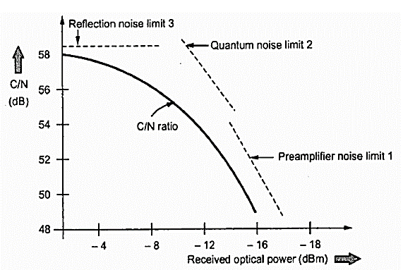
C/N ratio as a function of received optical power

Slide 13
Multichannel Amplitude Modulation

Slide 14
For N channels, optical modulation index is given by

Slide 15
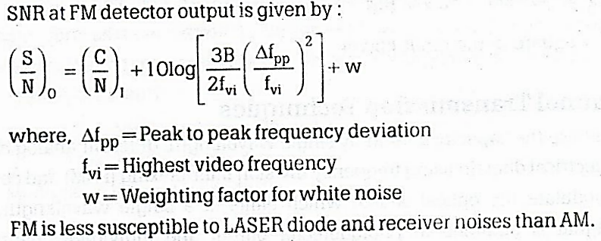
Multichannel Frequency Modulation

Slide 16
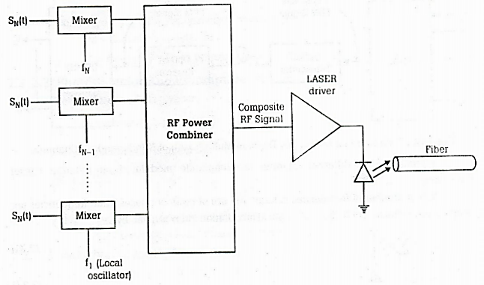
The basic SCM system

Slide 17
RF Over Fiber

Slide 18
